Slide 1
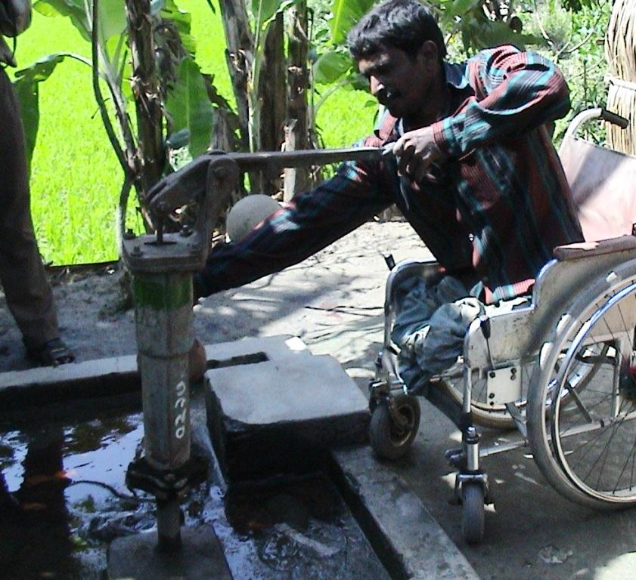
WASH and people with disabilities
Improving access for all
Hazel Jones
December 2011

Slide 2
Quick poll
What is the main focus of your work or experience?
Please select the option that most closely applies to you:
A Water, sanitation and hygiene
B Disability (e.g. service provider , NGO or DPO, personal experience)
C Education
D Other development sector

Slide 3
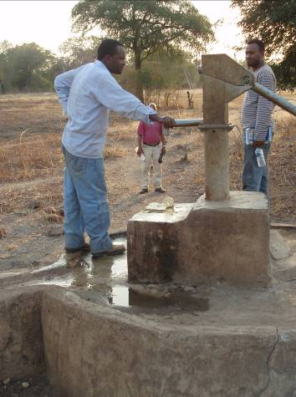
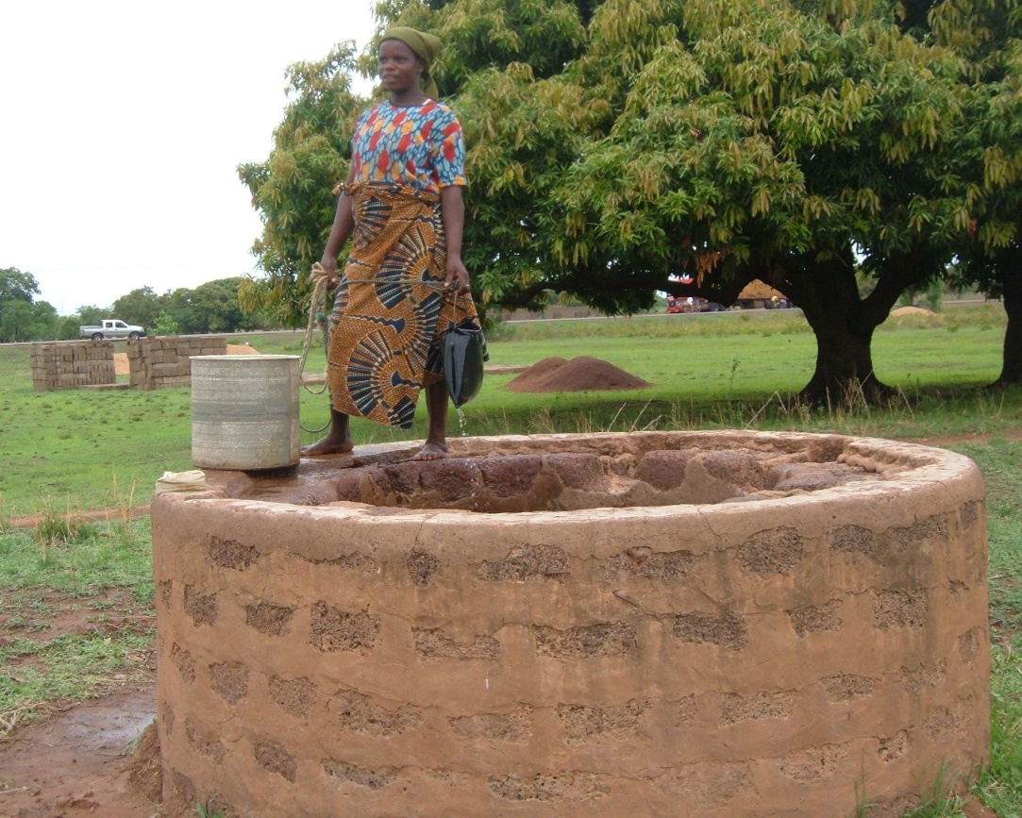
Fairly typical water sources
Photo: DDSP Cambodia
Photo: ADD Ghana
Photo: WaterAid Ethiopia

Slide 4
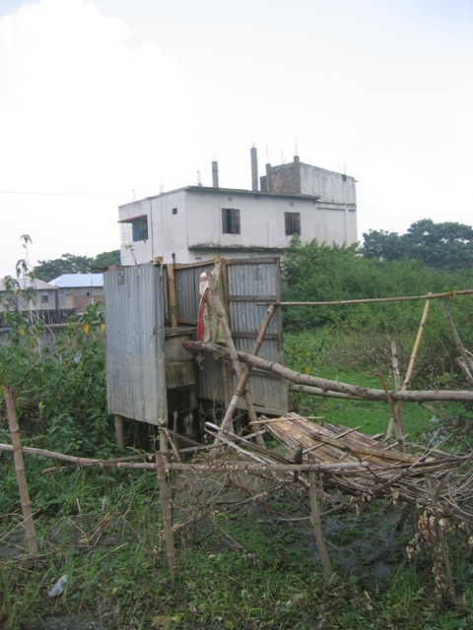
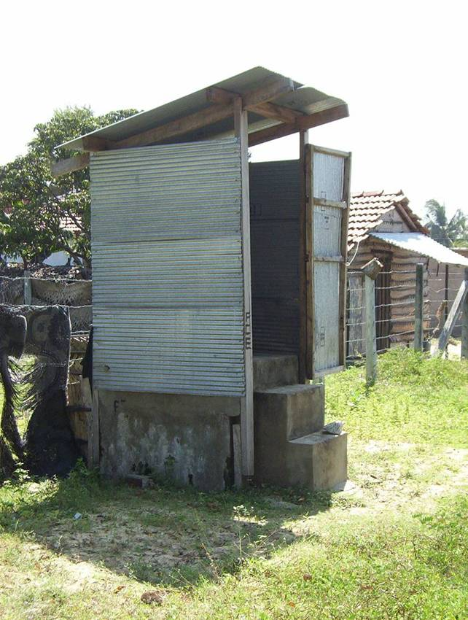
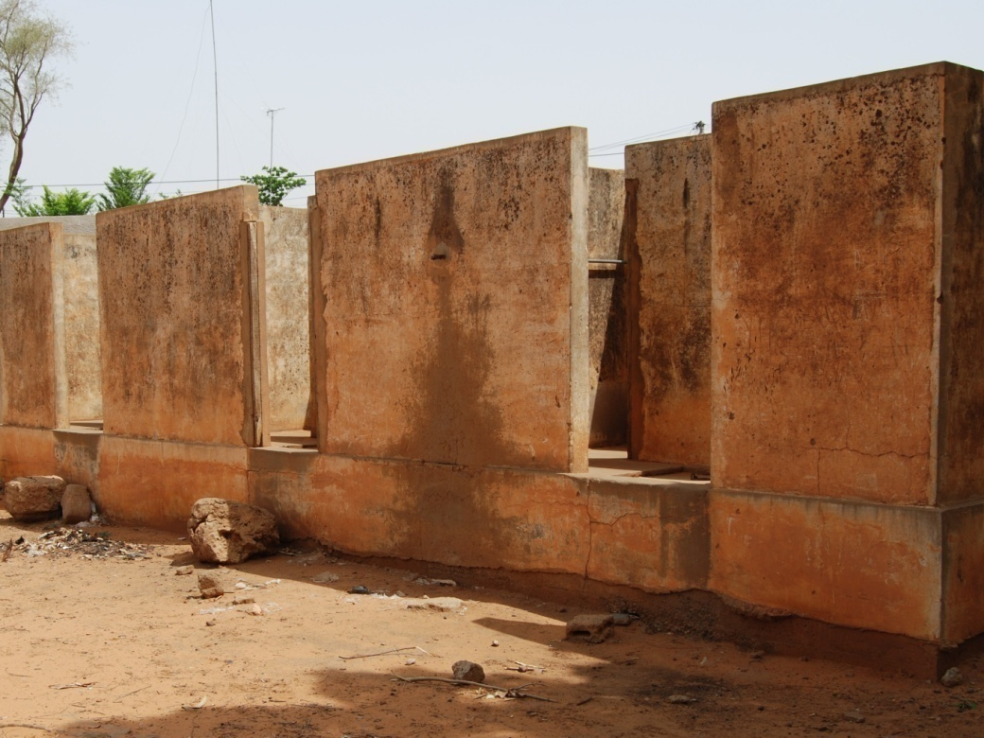
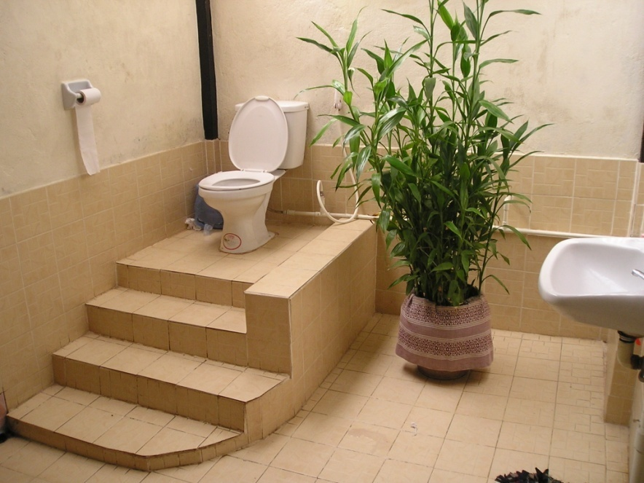
Photo: Handicap International Sri Lanka

Slide 5
Definition of disability
“Persons with disabilities include those who have long-term physical, mental, intellectual or sensory impairments which in interaction with various barriers may hinder their full and effective participation in society on an equal basis with others.”
(UN Convention on the Rights of Persons with Disabilities)

Slide 6
Individual models of disability
Activities focus on ‘fixing’ - curing or rehabilitating the disabled person so they can join ‘normal’ society
Segregates disabled people from mainstream society
Activities focus on ‘helping’ the disabled person who is a helpless recipient and outside ‘normal’ society
Disabled people are seen as helpless, unfortunate, dependent, suffering
Seen as needing pity and charity
Adapted from: World Vision (2011) Travelling Together

Slide 7
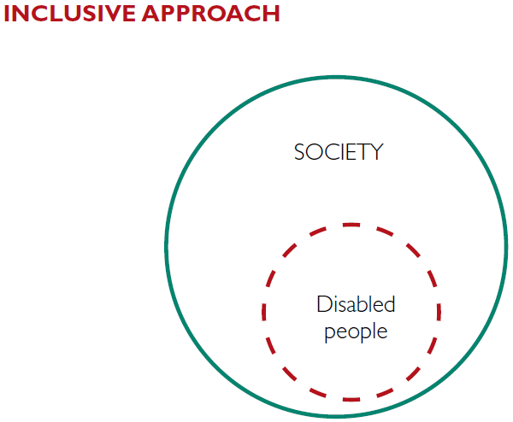
Social Model of Disability
Activities focus on inclusion – disabled people are part of society
Disabled people’s needs and rights are the same as those of non-disabled people – love, education, employment
Activities focus on identifying and removing barriers that prevent inclusion – attitudinal, environmental and institutional
Adapted from: World Vision (2011) Travelling Together

Slide 8
Poverty and Disability
DFID, 2000

Slide 9
Arguments for making WASH services accessible and inclusive
Poverty reduction: Inclusive facilities reduce workload of family, open up educational & employment opportunities
Health: Unhygienic sanitation practices affect everyone, but they affect disabled people even more
Educational: Disabled children often drop out or refused admission due to lack of accessible sanitation
Economic: The cost of making facilities inclusive is minimal compared to the costs of exclusion
Rights: Water is a human right for all, including disabled people (CRC, UN CRPD)
Gender: Disability and HIV/AIDS are gender issues; benefits to all.....

Slide 10
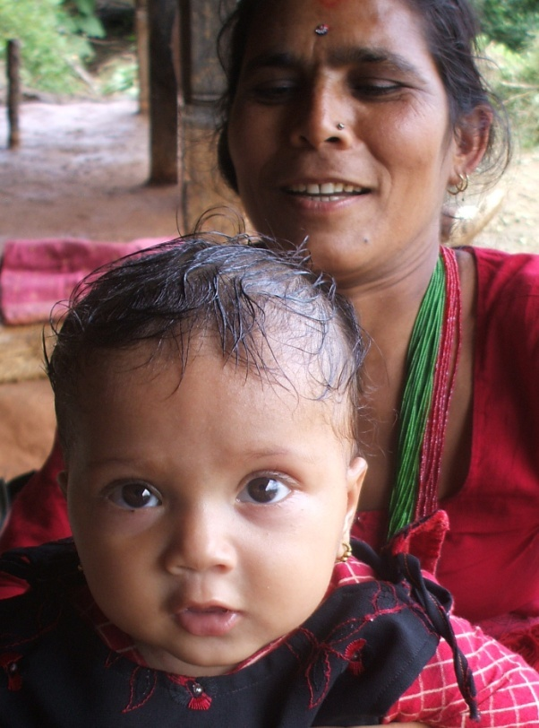
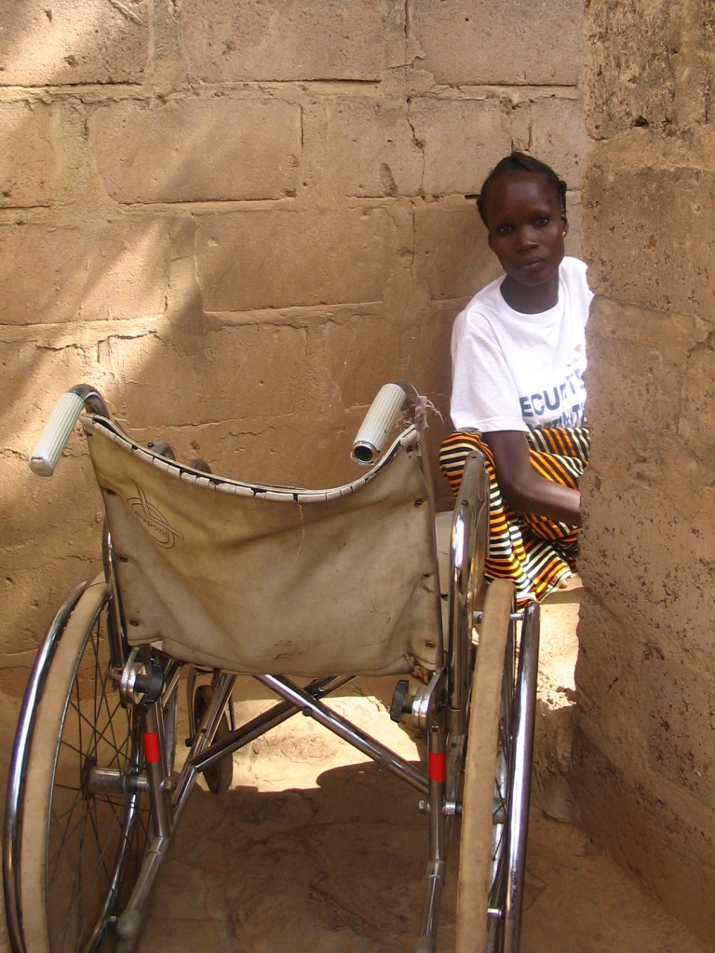
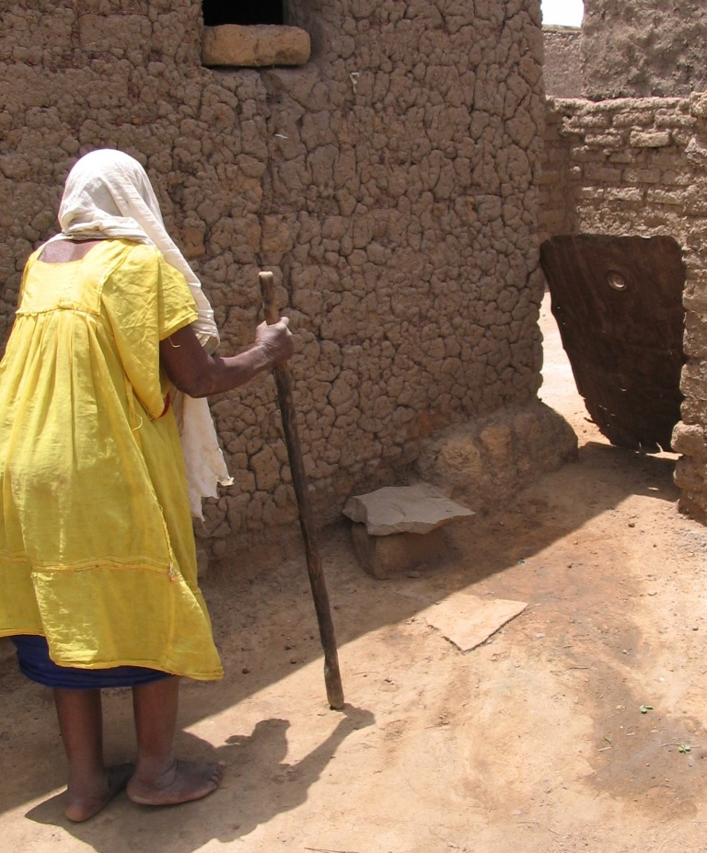
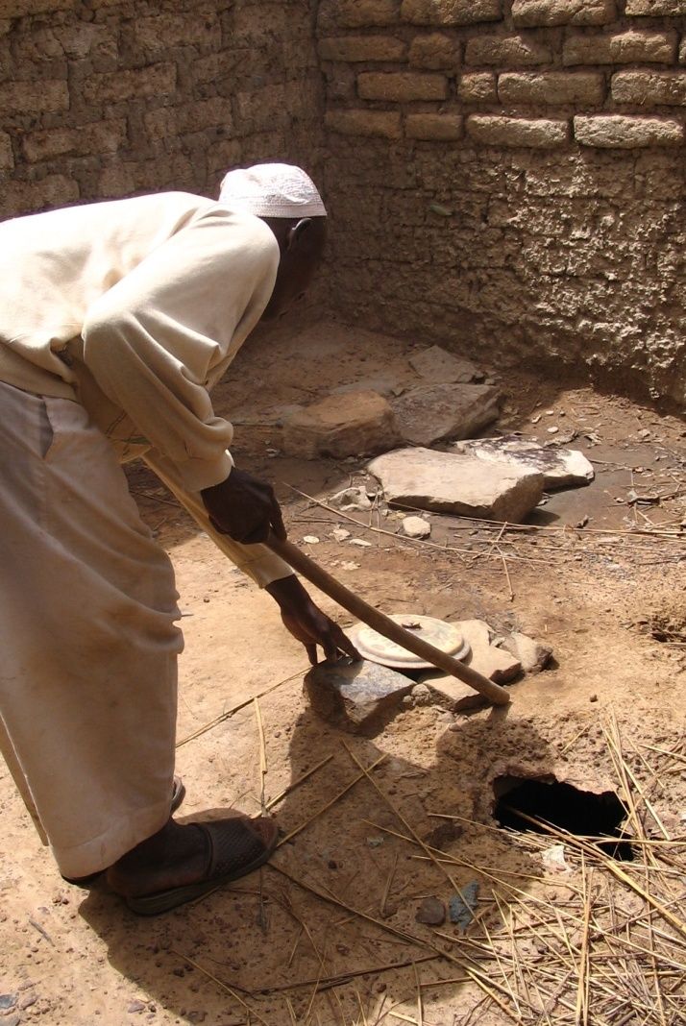
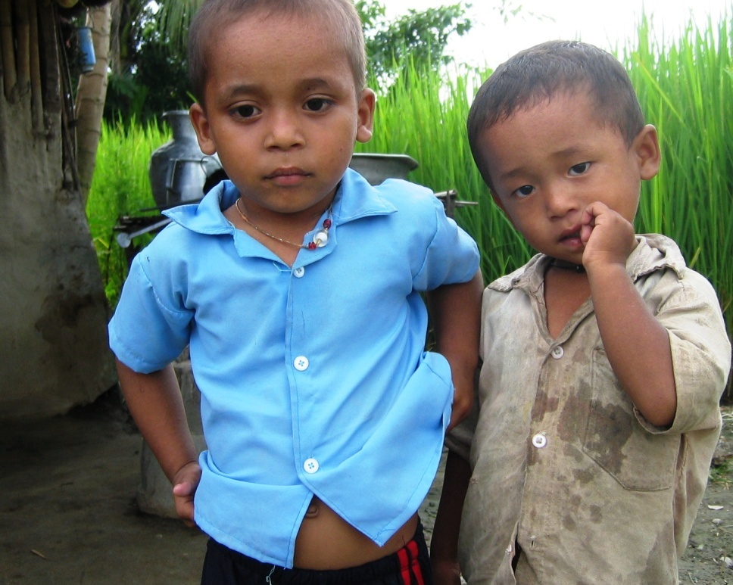
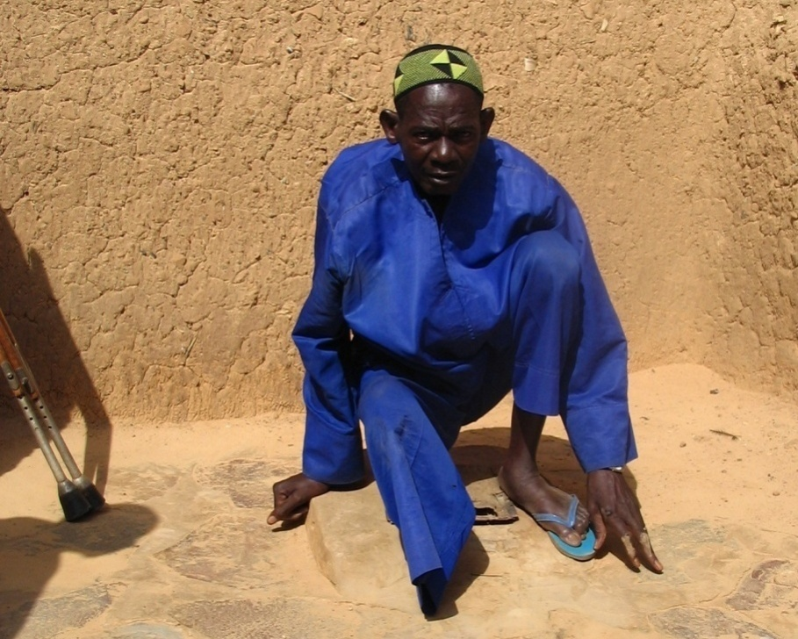
Who is affected?

Slide 11
Who should change, individuals or services?
Different shaped users are excluded
Standard ‘normal’ services for
‘normal’ round users
Figure 1: Standard service for the majority (Hazel Jones 2011)

Slide 12
Barriers to inclusion
Environmental - natural | Long distances, rough or steep paths, muddy ground...
Environmental - infrastructure | High steps, narrow entrances, no doors, slippery or dirty floors, narrow cubicles, no light...
Policy/ Institutional | Lack of policy/strategy, knowledge, skills, information, procedures for consultation with disabled people…
Social/ cultural/ attitudinal | Lack of information, traditional beliefs, pity, isolation, overprotection, stigma, prejudice, shame …

Slide 13
What are the most significant barriers?
In your view, what are the greatest barriers for disabled people to accessing and using water, sanitation and hygiene facilities and services?
A Individual limitations
B Environmental barriers (natural and built environment)
C Social and attitudinal barriers
D Institutional barriers (e.g. lack of policies, lack of information, training, procedures, etc.)
E Don’t know/ all/ none of the above...

Slide 14
Figure 2. Vicious cycle of barriers
Barriers can also be part of a self-reinforcing cycle
1. Disabled person has poor balance & difficulty squatting
2. Toilet has slippery floor, no handrail, making it difficult for disabled person to use
3. Disabled person can’t avoid soiling the toilet and their own clothes
5. Disabled person has low self- esteem
6. Unable to voice opinion, say what they need
7. Disabled person has low social status
4. Family reject the person, restrict toilet use
Question: Can you identify possible intervention points?

Slide 15
Physical Environment - solutions
For convenience, can be divided into:
Getting there
Getting in/on/ near
Usability
Notes:
Installers tend to only consider the technology itself, not the overall installation. The user is less concerned about the technology, more about how easy and comfortable it is to use, which includes:

Slide 16
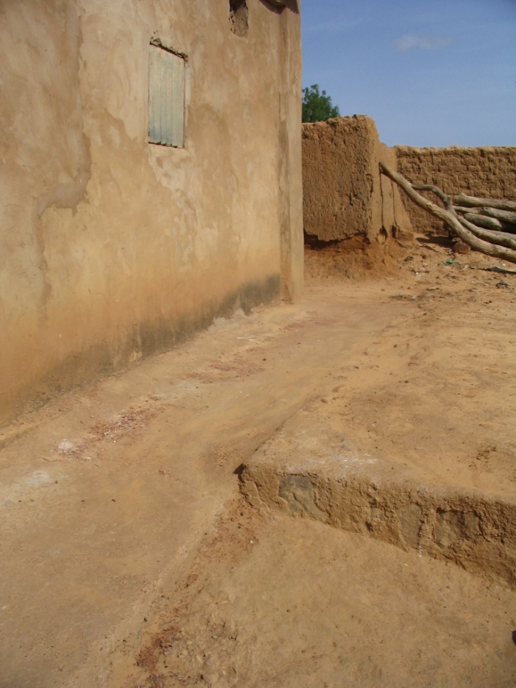
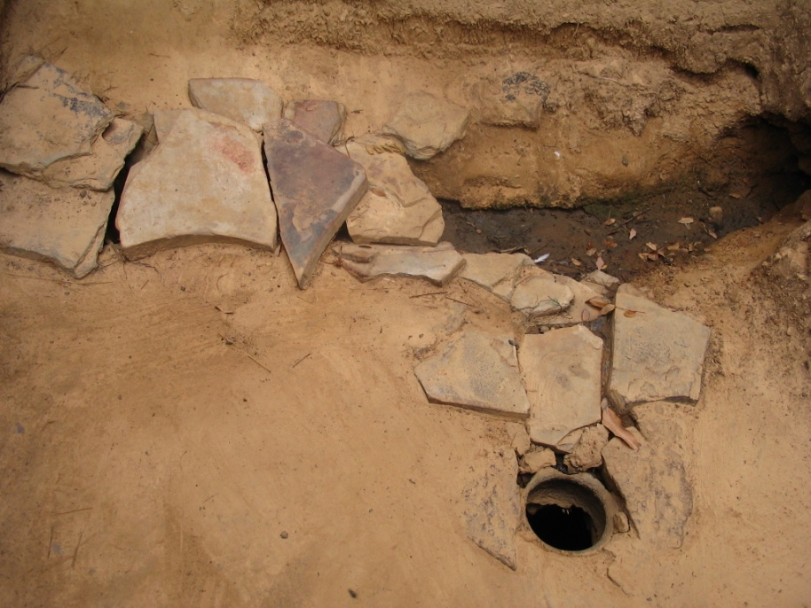
Getting there
Drains, ditches, etc. covered
Smooth paths

Slide 17
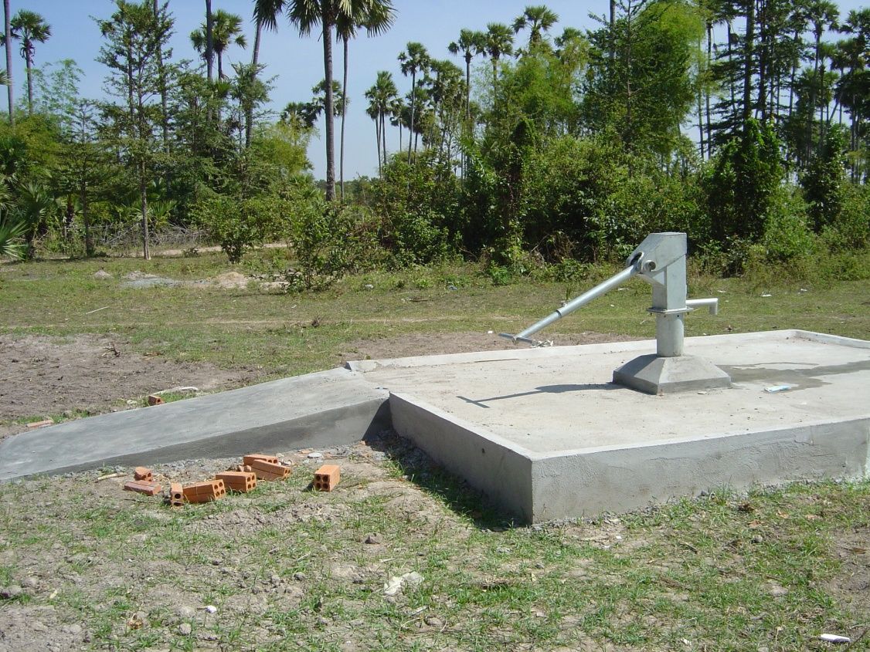
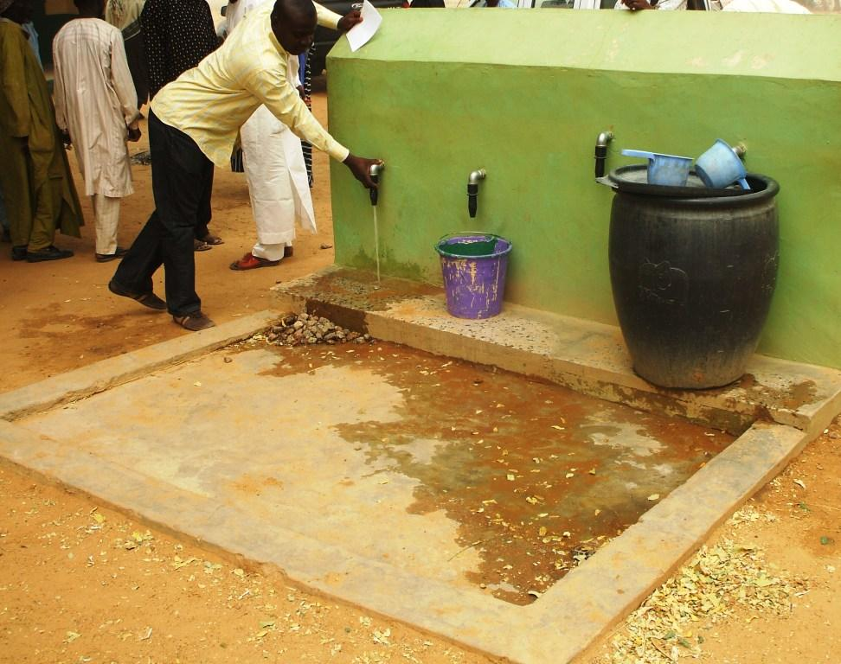
Getting in/ on
Photo: Philippa Thomas
Ramps
Minimise difference in height between apron and surrounding area
Photo: HITS Uganda
Notes:
Engineers are often thinking about drainage, not user-friendliness

Slide 18
Getting in - entrances
Photo: Handicap International Sri Lanka
Entrance wide enough for user + helper, wheelchair, stick, crutches etc.
Communal latrine with low steps & handrails
Notes:
R: In this IDP camp, there were no wheelchair users – the sandy ground made it impossible for them to get around. Accessibility therefore catered for people who could walk, but with difficulty, hence the handrails and low steps.

Slide 19
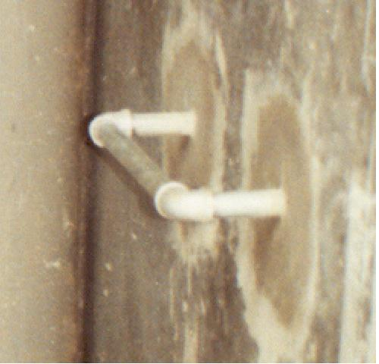
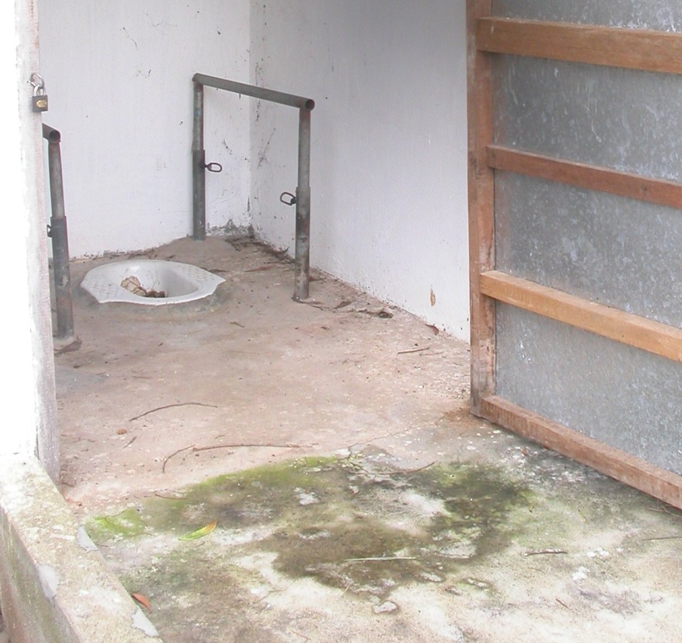
Support rails/ handles
May be fixed to the floor or wall
Source: Norman (2010)

Slide 20
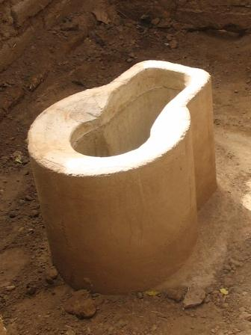
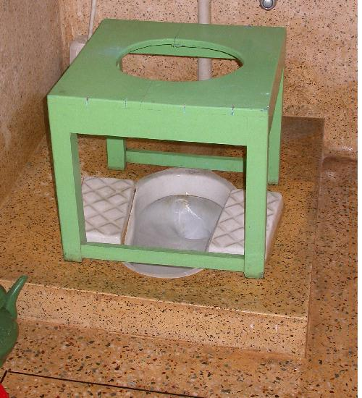
Seating options – fixed or movable
Concrete seat
Right - twin brick blocks
Source: Oxfam 2007

Slide 21
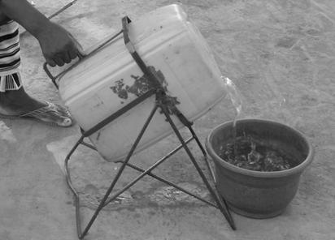
Water – transport, storage
Source: Norman (2010)
Photo: HITS Uganda
Wheelchair trailer
Jerry can tipper

Slide 22
Approaches to improving accessibility and inclusion
Individual approach
Provide aids & equipment to individuals, according to need
☑ meets individual needs
☒ labour intensive, high-cost, risk of further isolating users
B. Adaptation/Retro-fitting
Modifying/ adding to existing facilities
☑ inclusive, done as needed ☒ can be difficult, high-cost
C. Inclusive Design / Universal Design
Design and construct facilities that are accessible and easy for all to use.
☑ cost-effective, inclusive, systematic
☒ needs consultation & planning; can’t meet 100% of all needs
Notes:
A) Individual approach: may be more within the role of a therapist or community worker.
B) Retro-fitting, adapting or changing things afterwards is likely to be the most common, but can be expensive
C) The ideal for communal facilities is C) i.e. to design accessibility from the outset, which is the most cost-effective.
Inclusive Design, or Design for All; in the US, Universal Design, Barrier-free design
It is highly unlikely that 100% of users could ever be catered for with a single design. There will always be users with very severe disabilities or complex needs who cannot be catered for, but it is certainly possible to aim to maximise the proportion of users.

Slide 23
Public / household facilities
Household facility:
Limited number of users, mostly known,
Identifiable/foreseeable needs
 Requires basic user-friendly design + range of accessibility features to choose from.
Communal/institutional facility:
Large number of users, many unknown
Wide range of possible needs:
 Take “Inclusive design” approach
Notes:
You need to take a different approach depending on whether you are talking about household or communal facilities.
school toilet, clinic toilet etc.

Slide 24
Examples of household level solutions
Moveable toilet stool
Landmarks to guide older visually impaired woman

Slide 25
More household solutions
Support rail
Concrete toilet seat - household latrine

Slide 26
Special facilities response
Standard ‘normal’
services
‘Special’
facilities for ‘different’ shapes
Figure 2: Special needs approach (Hazel Jones 2011)
Standard service does not change.
‘Special’ – sometimes separate – services are provided for users with different needs

Slide 27
Inclusive design response
Community/ services
Figure 3: Inclusive design response (Hazel Jones 2011)
Service provider recognises that users are all shapes and sizes, with different needs.
It has changed the way it works, provides a flexible service to meet the needs of as many users as possible.

Slide 28
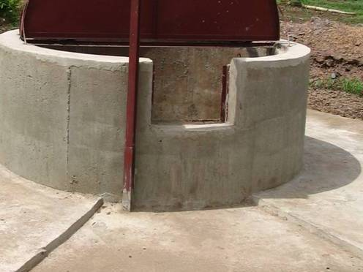
Examples of Inclusive Design approach*
Minimise difference in apron height
Taps at different heights
Well with low section of wall for use by children, wheelchair users, people who need to sit …
* none of them are perfect!

Slide 29
Examples of Inclusive Design (2)
Extra space inside latrine for
wheelchair to enter and turn, or
user + helper, or
to move a seat to one side when not in use
Changing and/or washing clothes
Change of ground texture signals arrival at the well apron

Slide 30
Examples of inclusive design (3)
Source: WaterAid Madagascar (2010)
Source: Ahmed & Yesmin (2008)
Handpump apron with ramp access and space for wheelchair to turn
Additional space provided for washing and drying sanitary napkins

Slide 31
Installation makes a difference
B
Same technology, different installation. Which of these handpumps do you think would be easiest for a disabled or older person to use – A, B, or C?
A
C
Photos:
WaterAid Ethiopia

Slide 32
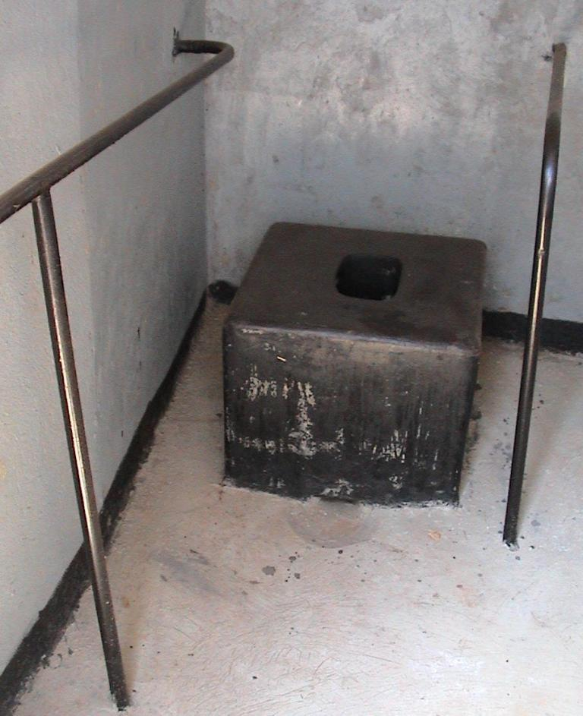
School facilities

Slide 33
Approaches to service delivery
Not only what you provide, but how it’s provided is important:
Data collection – ask the right questions
Consultation processes must be inclusive – ensure voices of poorest & least powerful are heard
Consultation with users – disabled people, women, older people, from planning & design stage onwards
ensures facilities more likely to be suitable, used, maintained and thereby sustainable
Informed choice information about technology options needed in user-friendly formats

Slide 34
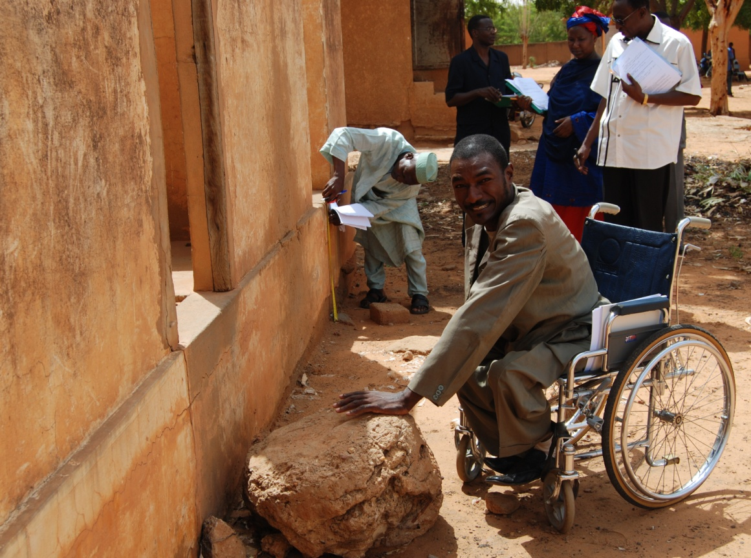
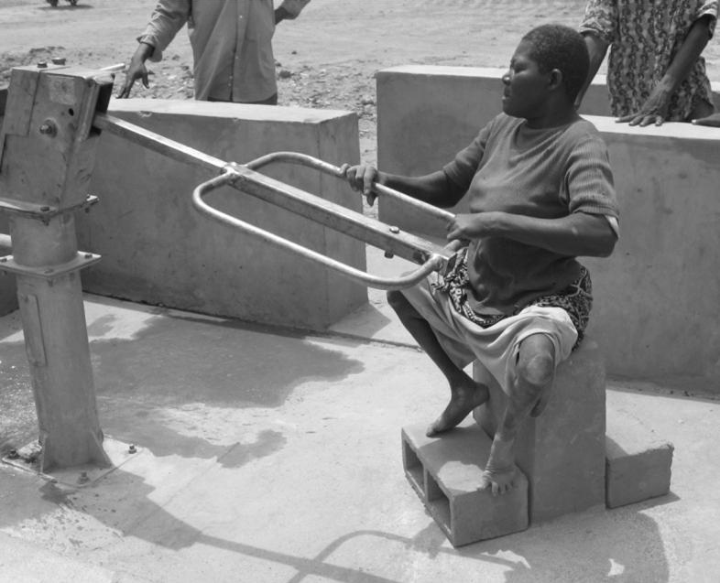
Accessibility audits
Assess accessibility & usability of facilities
Identify design improvements
Ideally involve both service providers and users
Source: Norman (2010)

Slide 35
Examples of practical initiatives - Cambodia
DPOs disseminated information about low-cost accessibility options
Individuals designed & constructed their own facilities
Improved their status in community
Role models for other disabled people
Long Kunthea and her accessible bathroom (Source: ADD website)

Slide 36
References
Ahmed, R. & Yesmin, K. (2008) Breaking the silence on menstrual hygiene in Bangladesh. Source Bulletin. IRC Delft. http://www.irc.nl/page/39141
Coe, S. & Wapling, L. (2010) Travelling Together: How to include disabled people on the main road of development. World Vision UK. http://www.worldvision.org.uk/what-we-do/advocacy/disability/travelling-together-publication/
DFID (2000) Disability, Poverty and Development. Department for International Development: UK.
Jones, H. & Reed, R.A. (2005) Water and Sanitation for Disabled People and other Vulnerable Groups: designing services to improve accessibility. WEDC, Loughborough University: UK. http://wedc.Lboro.ac.uk/wsdp
Jones, H. & Jansz, S. (2008) Disability and Sanitation. Briefing Note 3. WaterAid: UK.
Jones, H. (2011) Inclusive Design of School Latrines: How much does it cost and who benefits? Briefing Note #1. WEDC, Loughborough University: UK. http://wedc.lboro.ac.uk/resources/briefnotes/BN001_School_Latrines.pdf
OXFAM (2007) Excreta disposal for people with physical disabilities in emergencies. Technical Brief 1. Oxfam UK
Norman, R. (2010) Water, Sanitation and Disability in Rural West Africa: Enhancing Access and Use of WASH Facilities. A Summary Report of the Mali Water and Disabilities Study. Messiah College, USA.
UN (2006) Convention on the Rights of Persons with Disabilities (CRPD).
WaterAid Madagascar (2010) Accessibilité des Infrastructures communautaires d’adduction d’eau potable, d’assainissement et d’hygiène. Technical Briefing Paper 1
WELL (2005) Why should the water and sanitation sector consider disabled people? Briefing Note #12. WELL, WEDC, Loughborough University: UK.
Inclusive WASH & disability Key List. Ask Source: http://www.asksource.info/res_library/disability.htm
WEDC Knowledge base: http://wedc.lboro.ac.uk/knowledge/know.html

